Slide 1
Elements and Principles of Art
One of the most important things to look for in works of art is the way
those works have been designed, or planned. This involves knowing what
the elements and principles of art are and how they are used to create
art objects.
The elements of art are the basic components, or building blocks: color,
value, line, texture, shape, form, and space. Artists use the elements of art
to express their ideas. These elements are not the media the artist uses—
paint or clay or stone, for example—but the visual vocabulary used by
the artist.
The principles of art are the different ways the elements can be used in
a work of art: balance, emphasis, harmony, variety, gradation, movement,
rhythm, and proportion.
We can make a comparison with writers who must do more than just
select and randomly arrange words if they are to communicate their ideas
to others. The elements of art can be compared to words. How writers
organize those words is similar to using the principles of art. Writers form
phrases, sentences, and paragraphs. Then they must carefully arrange
these into meaningful sequences. The words must be organized so that
readers can understand and appreciate their ideas.

Slide 2
14 Elements of Art & Design

Slide 3
QUICK VOCABULARY REVIEW
Color conveys atmosphere and mood
Line conveys movement as well as mood
Shape can either be geometric or organic
Form is a 3-dimensional form
Texture is the quality of the surface on an object
Value deals with lightness or darkness of a color
Balance is the way pieces in an artwork are arranged; equal weight on equal sides
Contrast is the arrangement of opposite elements; light vs dark, rough vs smooth
Emphasis is an area of focus or focal point in an art piece; draws attention
Movement is using art elements to direct a viewer’s eye along a path or through the artwork
Pattern is repeating artistic elements in a consistent, regular manner
Rhythm is a combination of artistic elements repeated, but with variations
Unity is the relationship between the elements that helps them function together
Space refers to distances or areas around, between or within components of a piece

Slide 4
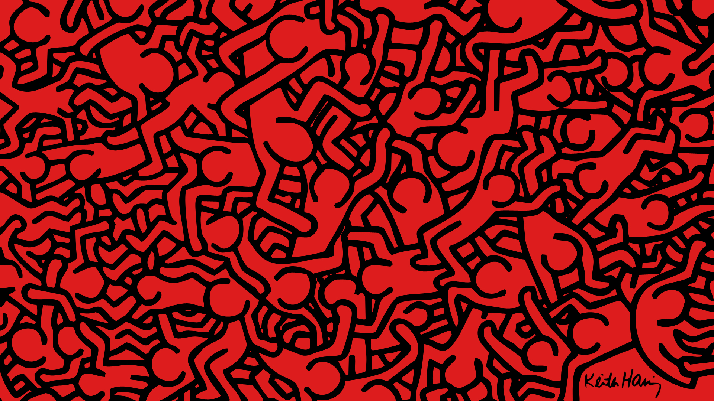
Find an example of the following elements of design, ONE piece per Element.
Shape, Form, Balance, Contrast, Emphasis, Unity, Space
Write a short description on HOW the piece embodies that
particular element of art.
You CANNOT use 2 of the same art pieces!
Notes:
This piece illustrates what elements of art?

Slide 5
DIRECTIONS BREAKDOWN
Research and find art pieces for the given Elements of Art
Put those jpgs on ONE Illustrator 8.5 x 11 file
Write a short description of the piece and how it illustrates your chosen principle.
Go into specific details!
(30 min)

Slide 6
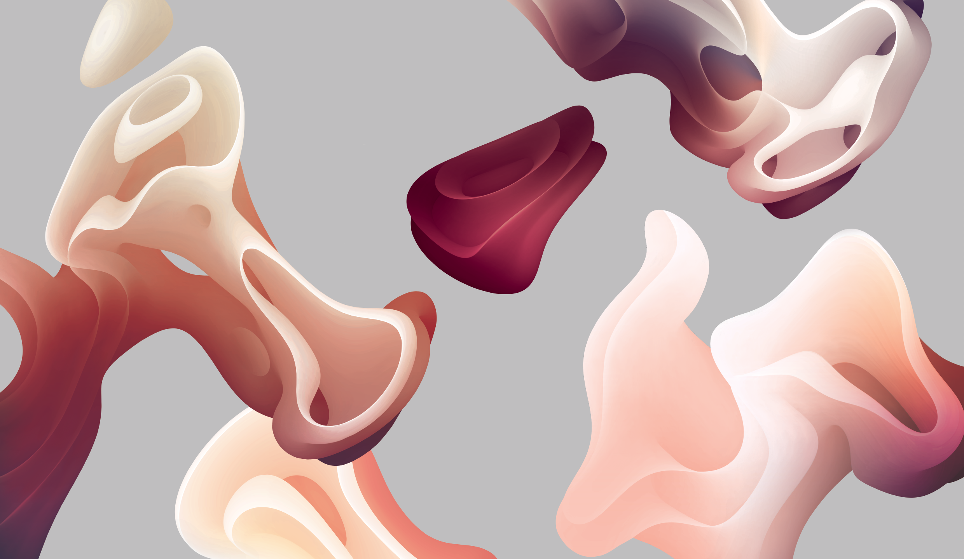
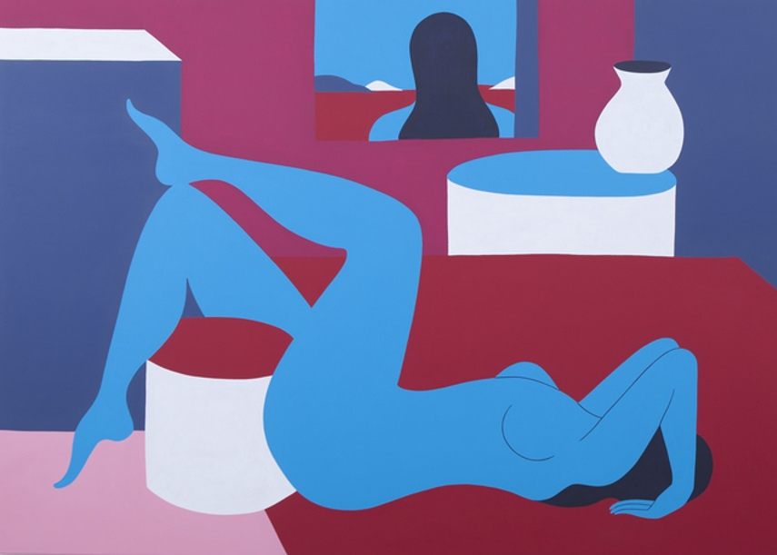
The examples on your artboard should look like this:
MOVEMENT
This piece called “Loop”
by Maria Gronlund shows
movement by illustrating
organic shapes flowing around
the canvas, giving the illusion
of movement.
COLOR
“Lazy Monday” by Piet Parra
shows how the use of color
can set a peaceful tone as the
colors here illustrate with dark,
muted colors and pops of brighter
colors bringing focus to the
foreground of the piece.

Slide 7
NEXT: Present your knowledge
Each of you will share out one artist + art piece you chose and I will project the piece.
You will then explain how your chosen element applies to that piece.
i.e. “You can see texture where…”
“This piece shows contrast by...”
”The artist used... to show…”

Slide 8
LIGHTNING ROUND
Raise your hand as soon as you know which element(s) of art
are most present in the next slides!
Explain in detail why you think the piece reflects the element you’ve chosen!

Slide 9
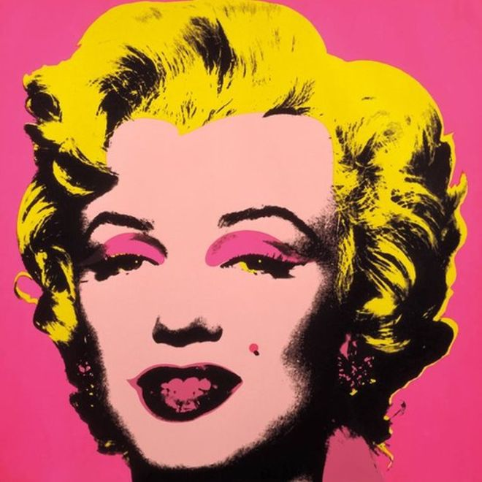

Slide 10
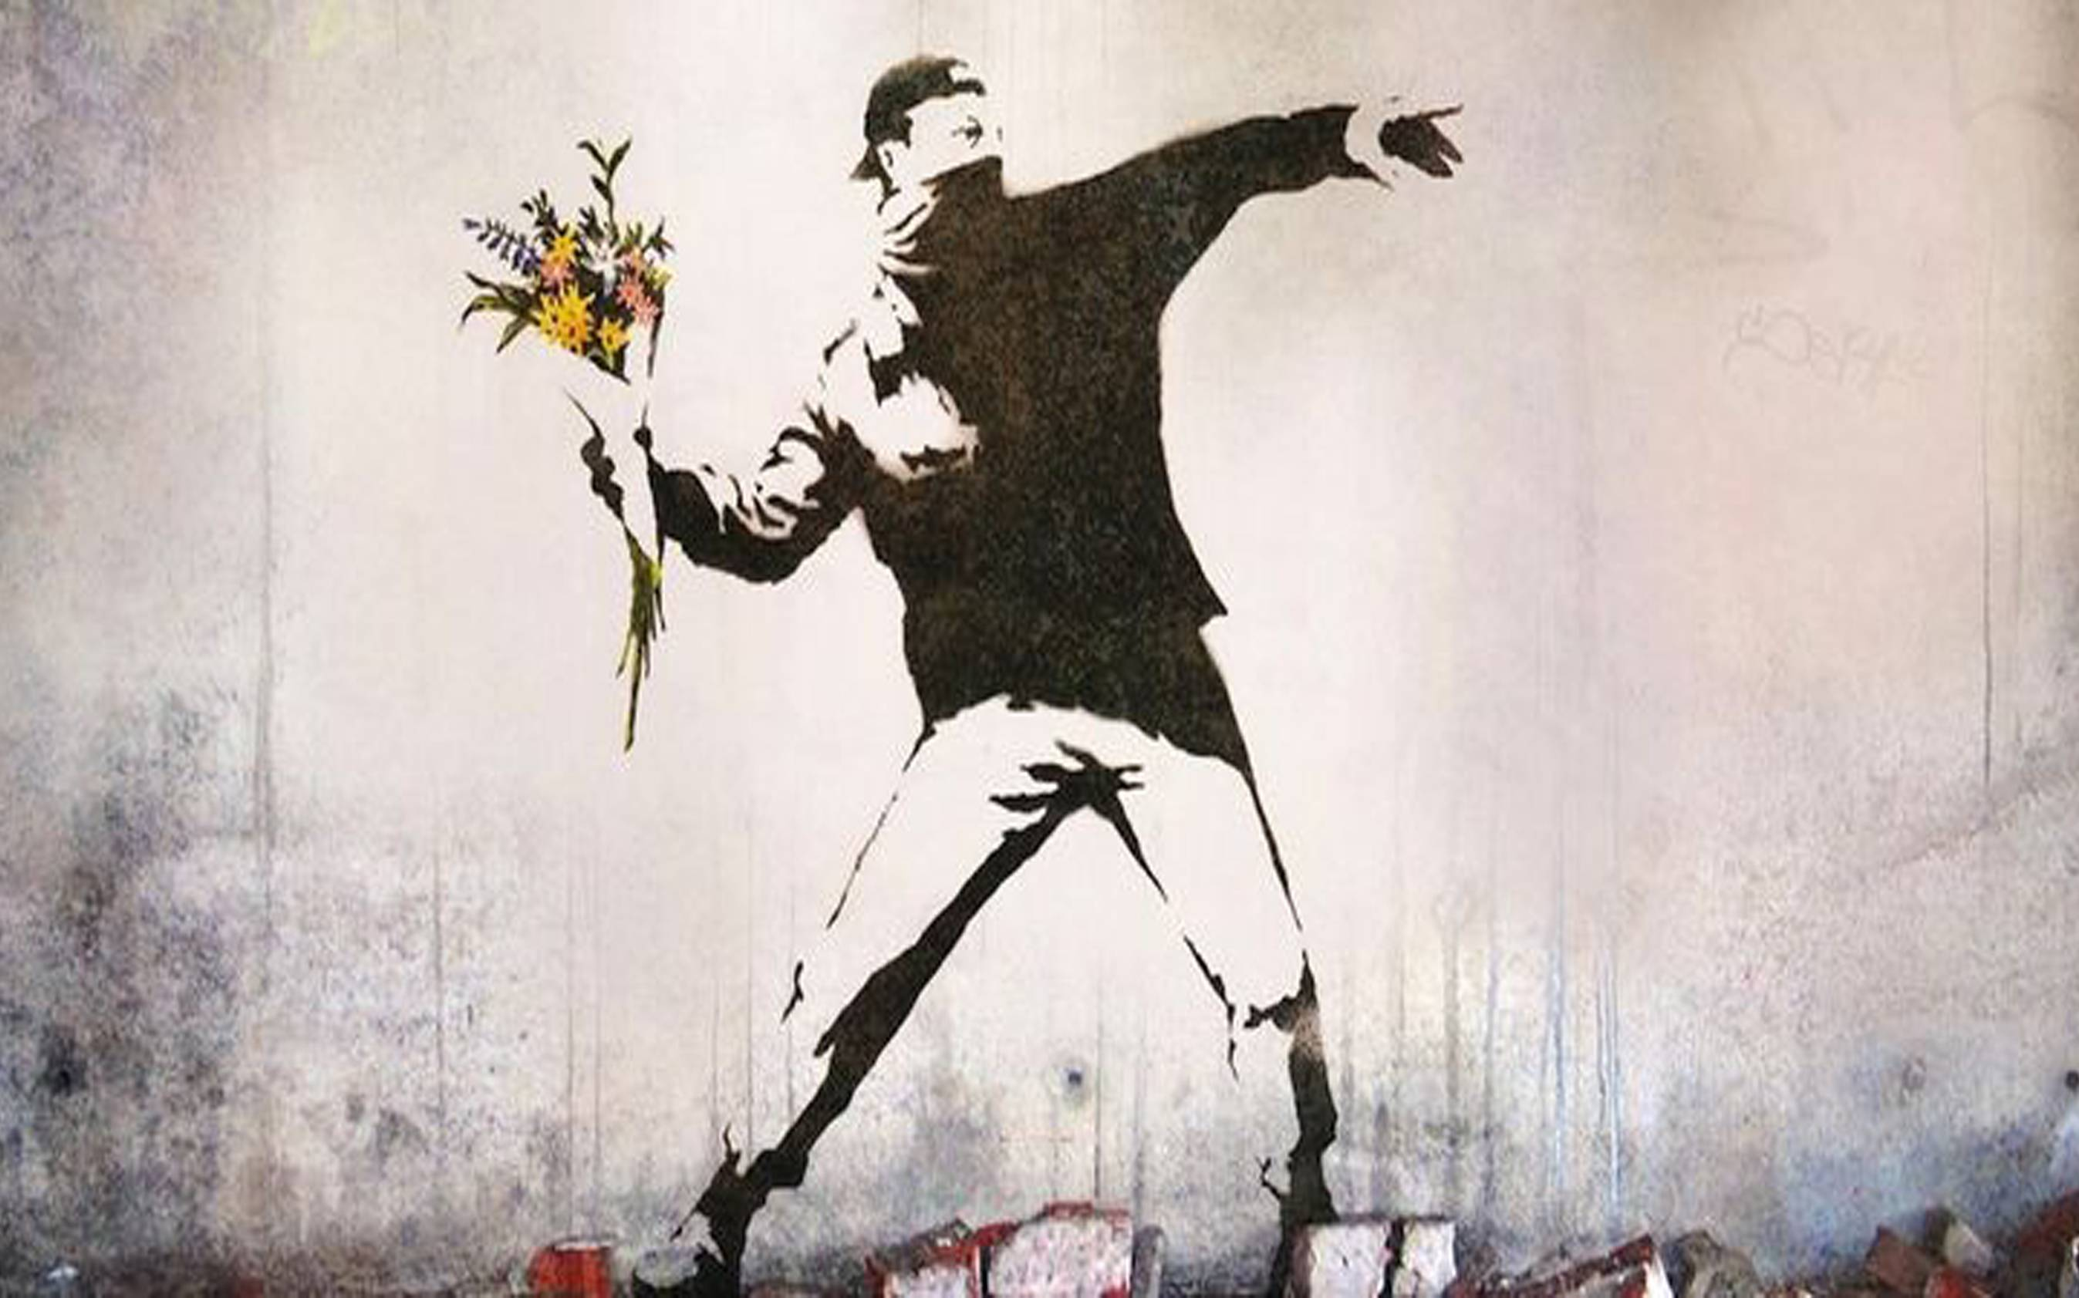

Slide 11
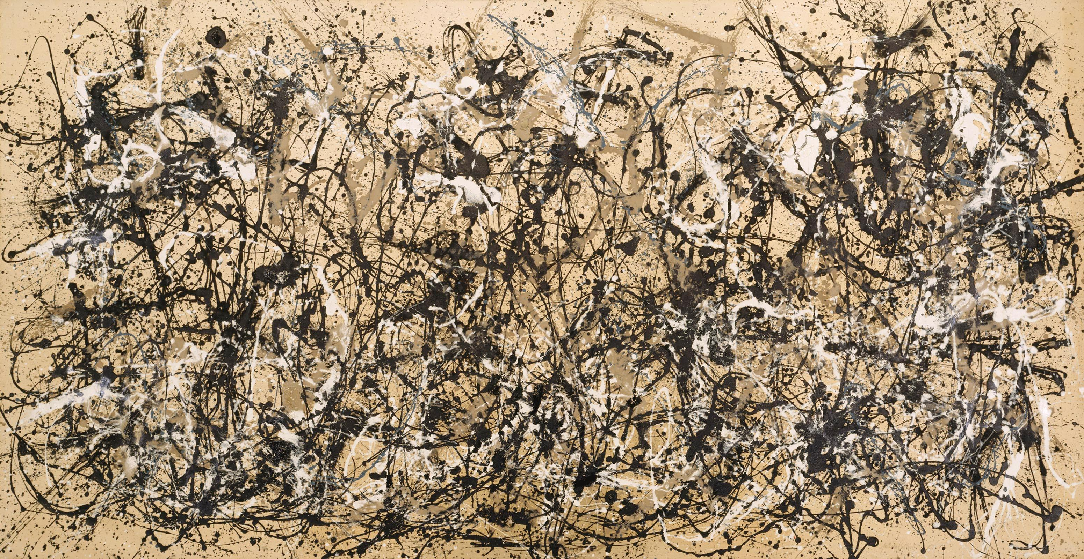

Slide 12
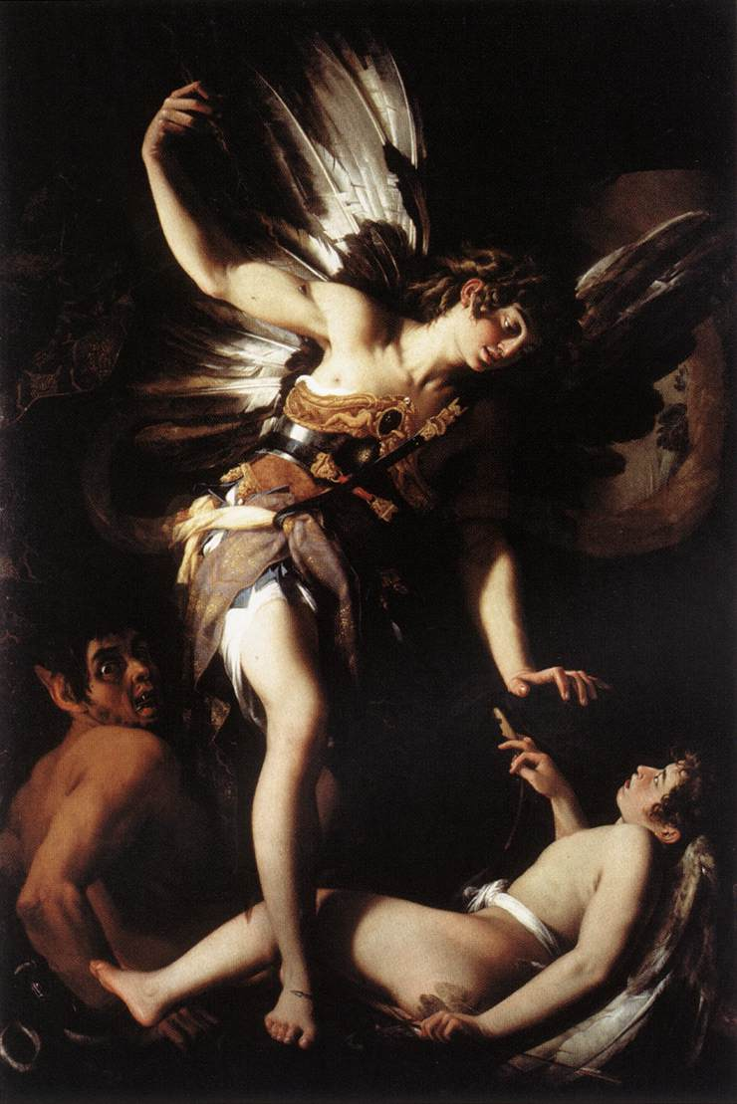

Slide 13
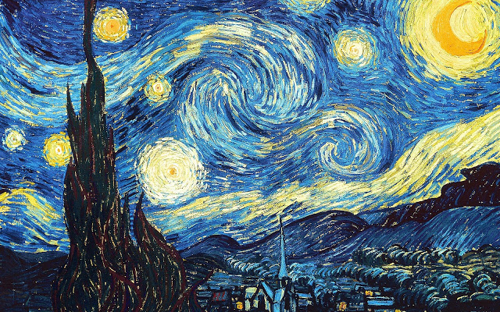

Slide 14
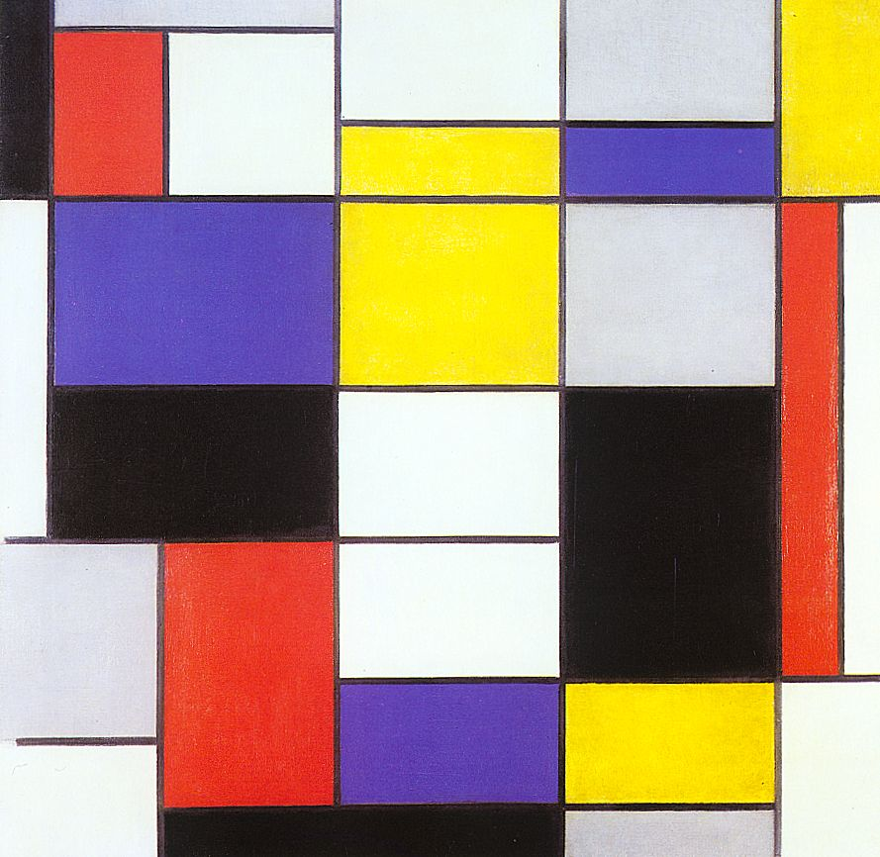

Slide 15
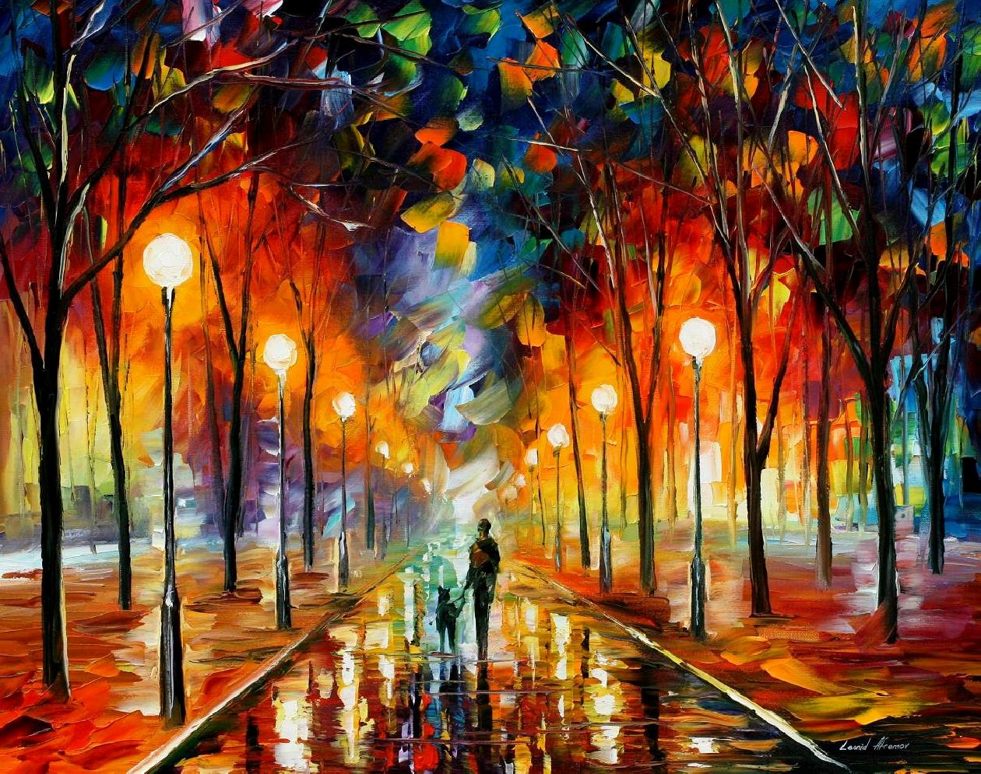

Slide 16
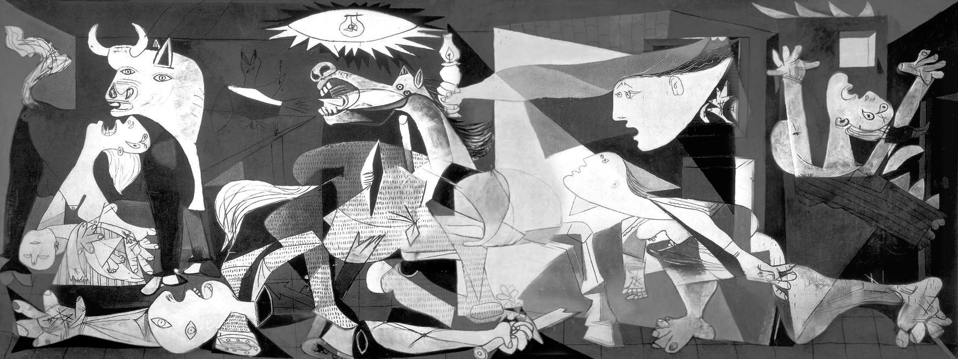

Slide 17
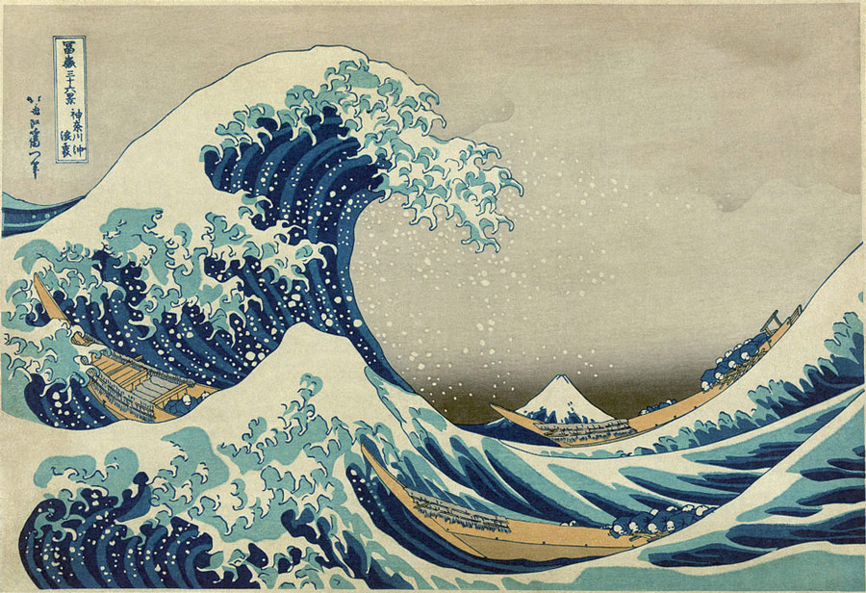

Slide 18
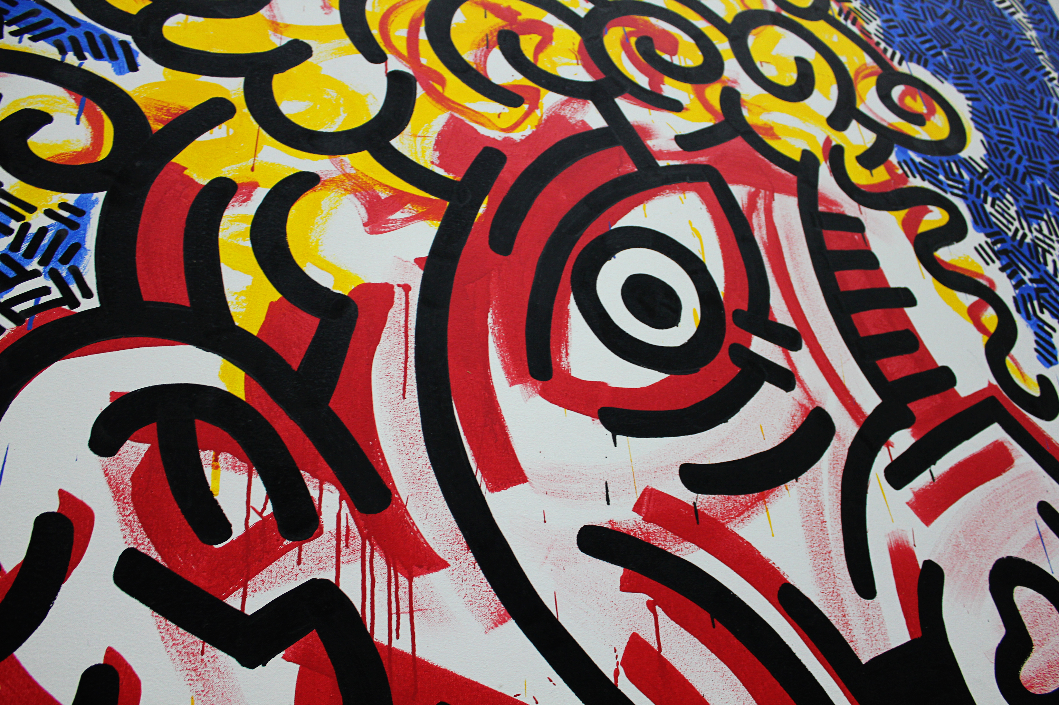

Slide 19
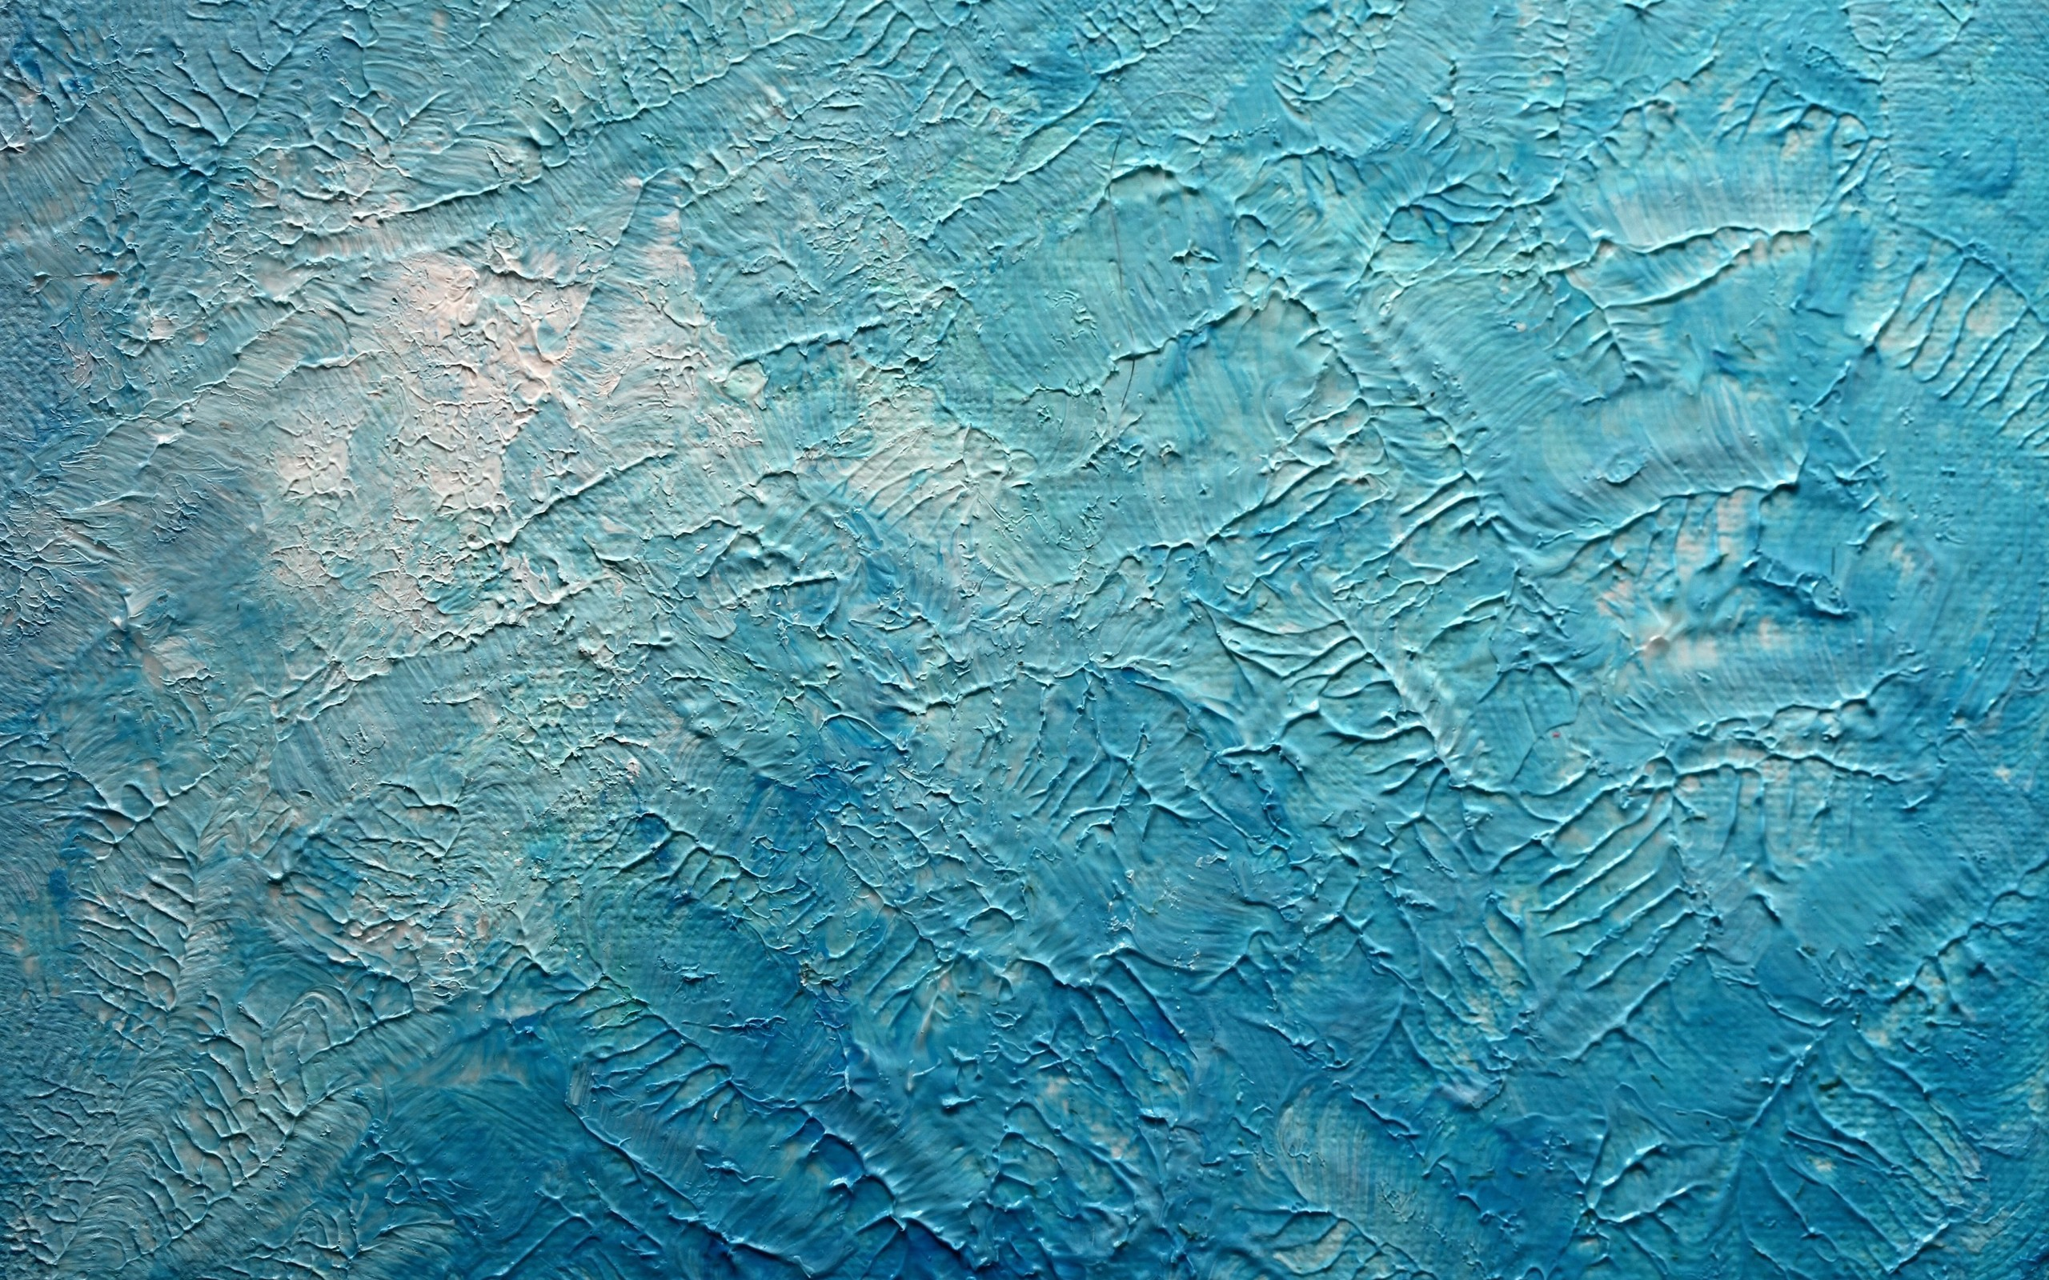

Slide 20
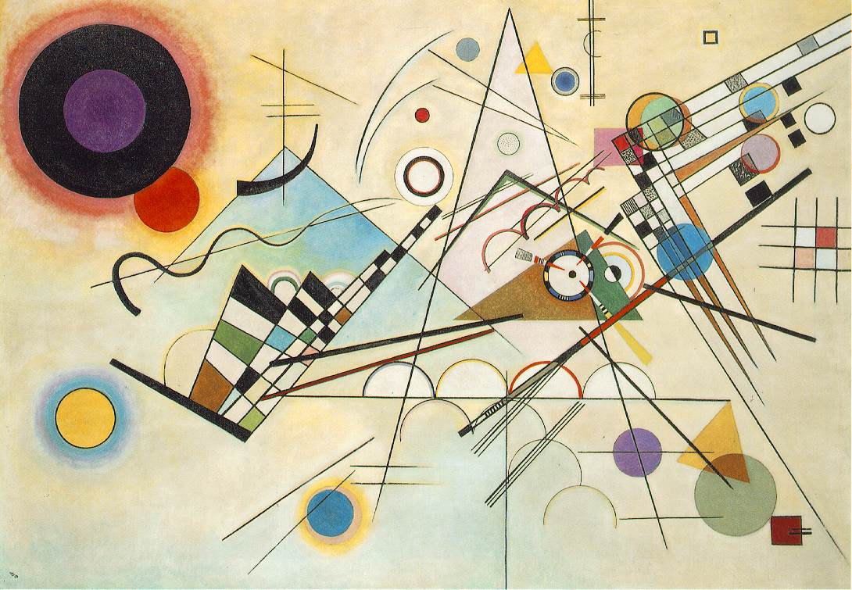

Slide 21
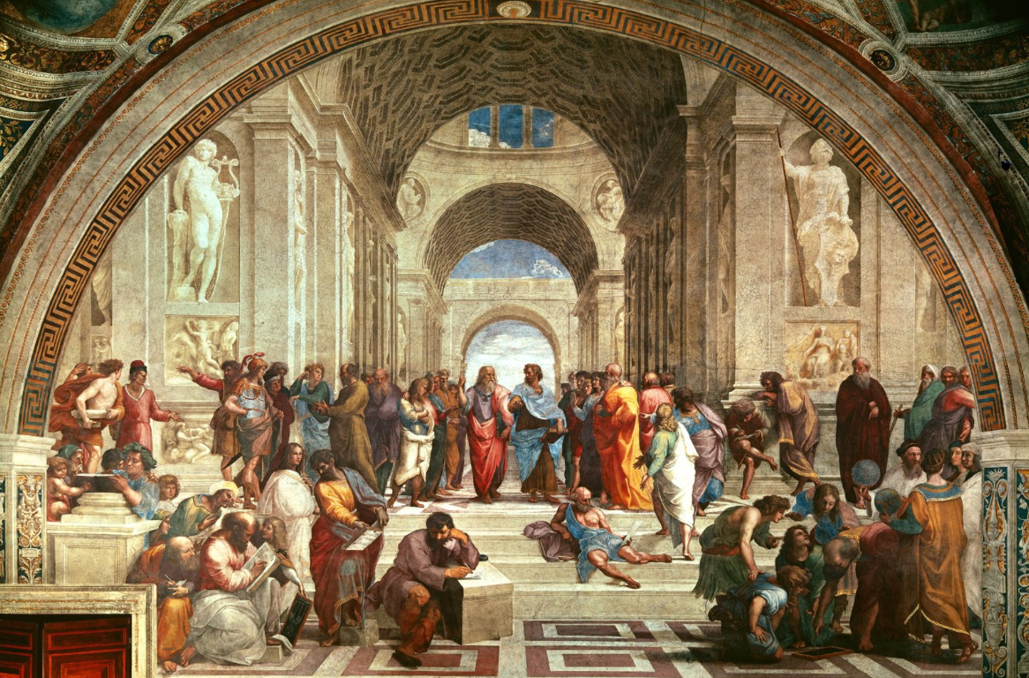

Slide 22
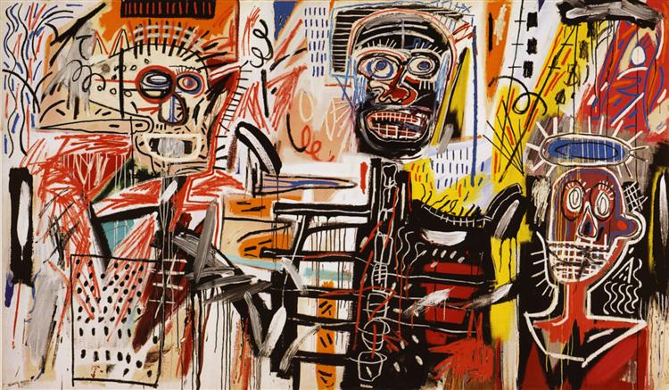

Slide 23
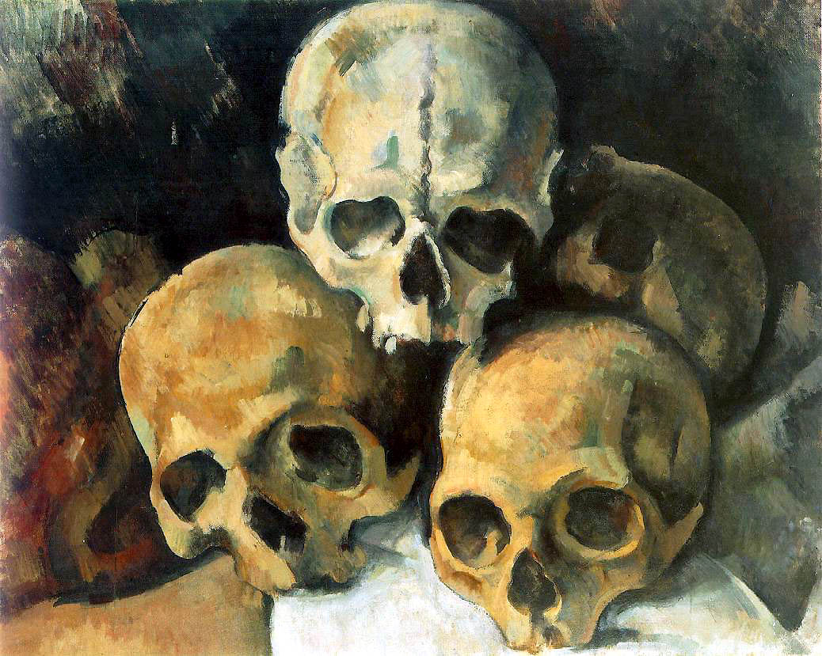

Slide 24
For the remainder of class…

