Slide 1
“Though often overlooked, Graphic Design surrounds us… it is the signs we read, the products we
buy, and the rooms we inhabit. Graphic Designers find beauty within limitations, working towards
the ultimate goal of visually communicating a message. Utilizing a language of type and imagery,
Graphic designers try to make every aspect of our lives defined and beautiful.”
- Arthur Pringleton

Slide 2
What is graphic design?

Slide 3
What is graphic design?
Graphic design is…
the arrangement of text, images, and color to express a message
visual communication to solve problems using typography, photography and illustration.

Slide 4
What is graphic design?
Typography is the style and appearance of anything printed
the art or procedure of arranging type (the way the letters or words are laid out)
Photography is the science, art, application and practice of creating durable
images by recording light
Illustration is a visual explanation of text (i.e. an illustrated page in a book, the cover of a comic book)

Slide 5
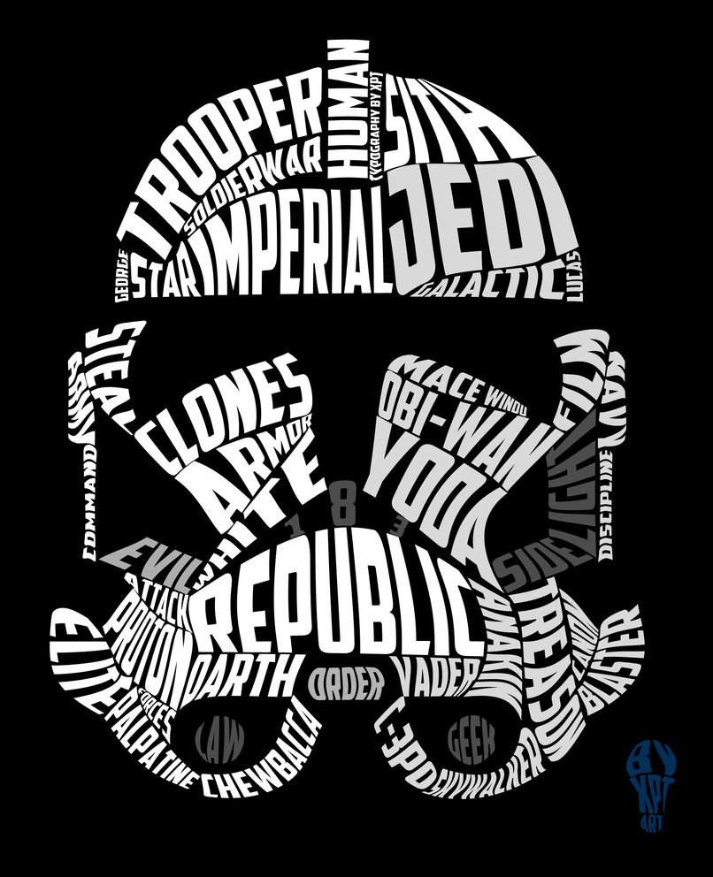

Slide 6
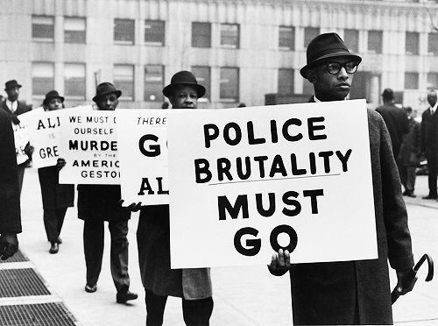

Slide 7
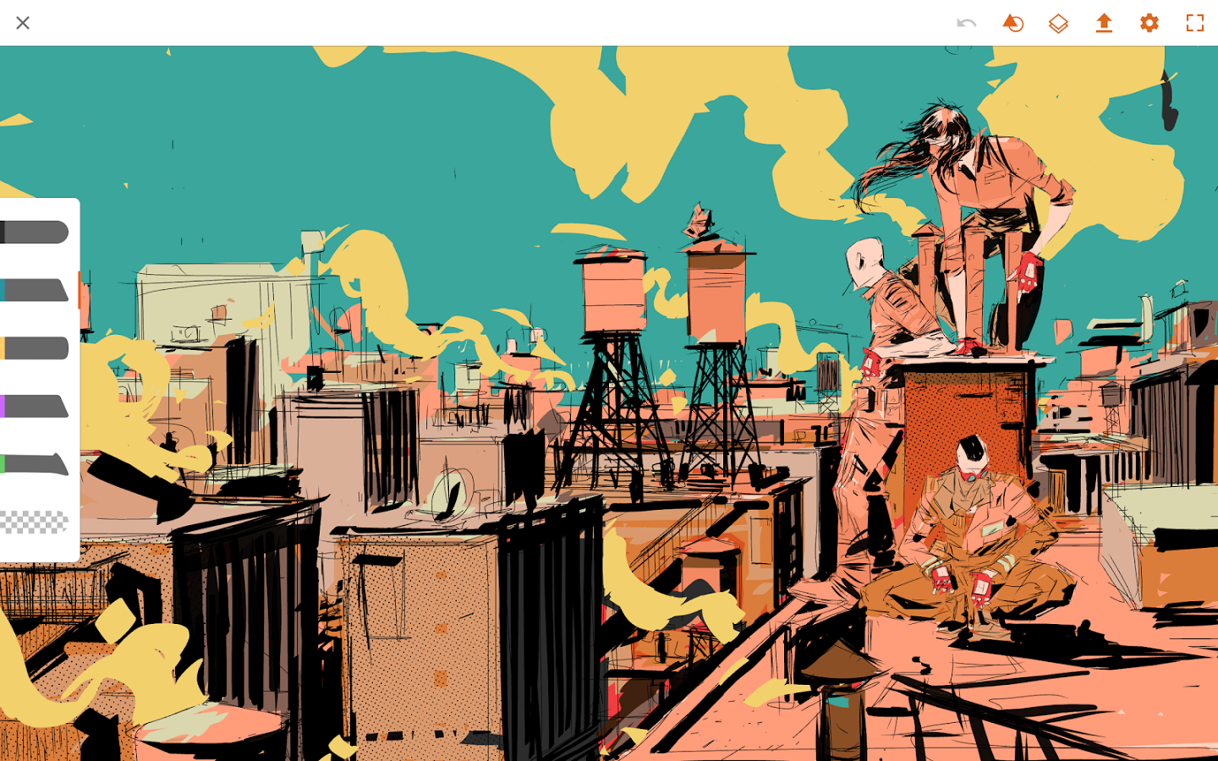

Slide 9
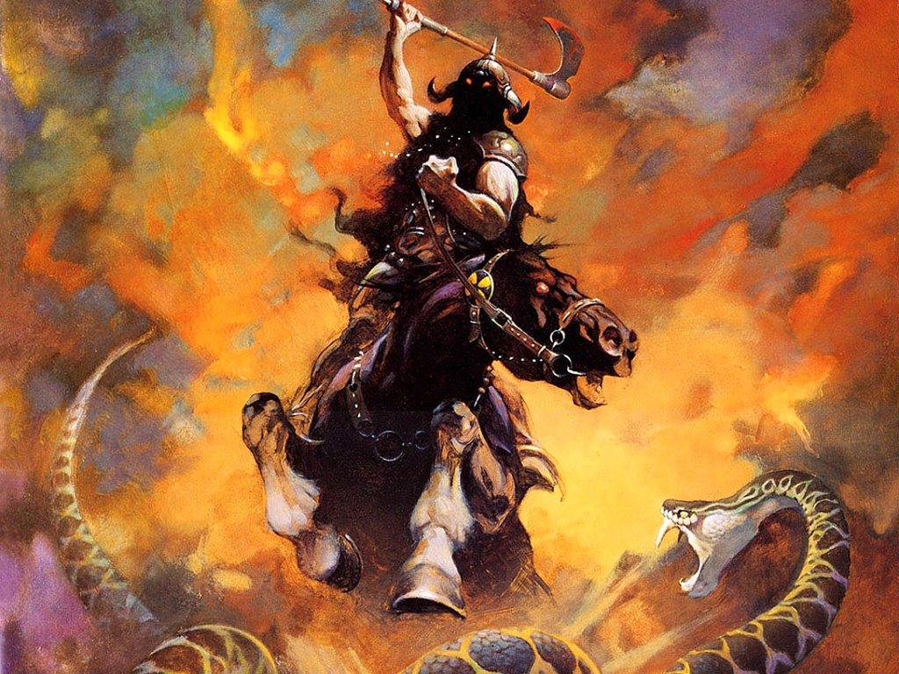

Slide 10
Back to that definition….
… with the visual communication stuff and why we need it.

Slide 11
(Based on true events)

Slide 12
The townspeople have a real world problem.
The townspeople implore the graphic designer, “Our kids keep getting hit by these dang ‘ol automobiles!”
The graphic designer tells the townspeople, “I’ll design a sign to inform people of your impending children.”
Town idiot: “Gee-golly, that’s a bright idea, mister!”

Slide 14
A brief list of careers in graphic design includes:
⋅ advertising (promotional) design
⋅ book design
⋅ book jacket design
⋅ brand and identity design
⋅ corporate communication design
⋅ editorial design
⋅ environmental design
⋅ interactive (experience) design
⋅ illustration
⋅ information design
⋅ motion design
⋅ package design
⋅ publication design
⋅ retail design
⋅ wayfinding design

Slide 15
Intro to Graphic Arts Video / Quotes Activity
https://www.youtube.com/watch?v=sTi5SNgxE3U
Take 2 quotes from each designer and answer this questions for each quote:
1. Why is this quote meaningful?

