Slide 1
Warm-Up (Sketchbook)
Write (5 minutes):
The Annunaki are a race of advanced beings who may or may not have visited Earth almost 500,000 years ago.
Describe the first encounter between our ancestors and these space travelers. Who initiates the encounter?
How did they communicate? What is their reason for visiting Earth and how can they help us? Is this meeting
friendly or aggressive? What do they look like? Be creative and get specific.

Slide 2
Warm-Up (Sketchbook)
Write (5 minutes):
The Annunaki are a race of advanced beings who may or may not have visited Earth almost 500,000 years ago.
Describe the first encounter between our ancestors and these space travelers. Who initiates the encounter?
How did they communicate? What is their reason for visiting Earth and how can they help us? Is this meeting
friendly or aggressive? What do they look like? Be creative and get specific.
Draw (5 minutes):
2 symbols.
1 for “Peace”.
1 for “War”.
Think about symbols being a universal language.

Slide 3
AGENDA
Project Reflection (15/20 minutes)
Intro Photoshop / Demo
Collage

Slide 4
DEMO
Take notes in your sketchbook.
Maybe even follow along in Photoshop.

Slide 5
DEMO EXIT TICKET
6 random images into one.
(10 minutes)

Slide 6
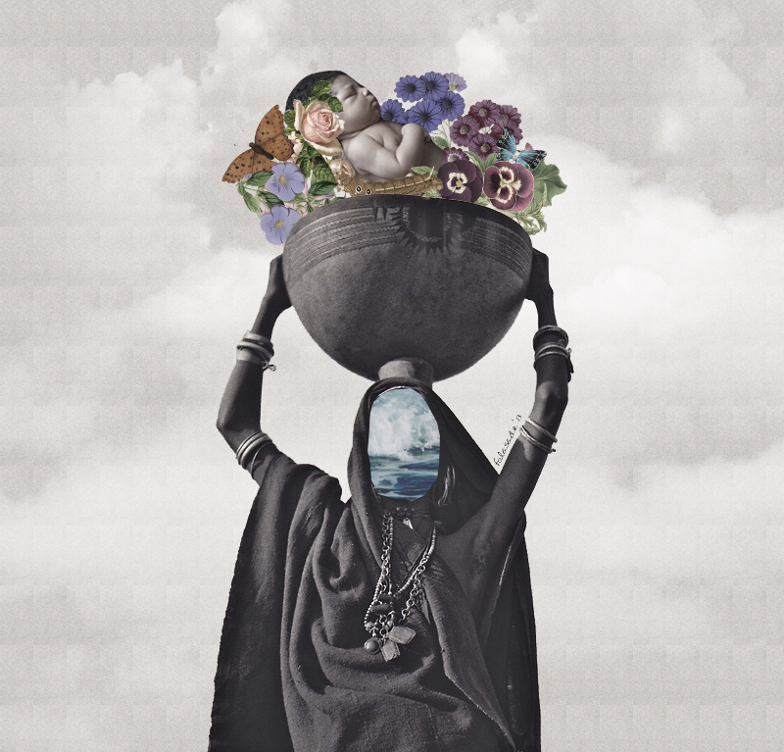
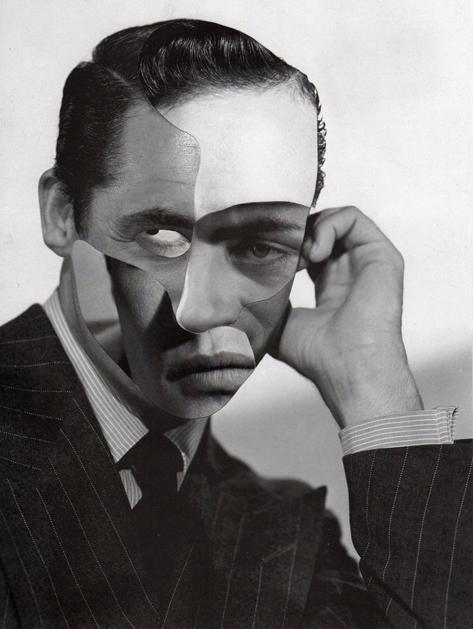

Slide 7
Create a Collage with a hidden meaning in it.
The meaning must be personal to you but that you’d be willing to explain on paper.
The meaning must also be meaningful.

Slide 8
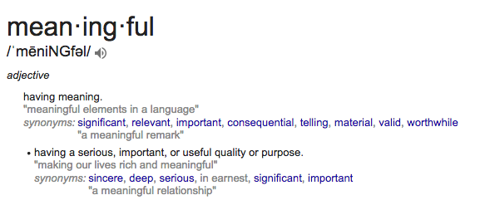
Create a Collage with a hidden meaning in it.
The meaning must be personal to you but that you’d be willing to explain on paper.
The meaning must also be meaningful.

Slide 9
ESKs 1/2/5
Demonstrate understanding of Cutting and Collage using Photoshop
Make a connection to your piece through writing / analysis
Demonstrate understanding of the Elements of Art
Specs:
8 ½” x 11”
Color Collage (can have black and white elements within your composition)

Slide 10
Requirements for the Artwork:
You must clearly demonstrate TWO Elements of Art.
You must have a hidden message about something personal that you’d be willing to share on paper.
You must use 30+ individual photos to create your collage
Requirements for the Writing Content:
You must write a half paper.
The half paper must cohesively (clearly and with connection) explain your hidden message.
Your hidden message will remain with me (Unless you’d like to explain it in presentation form later).
3. In your half paper, you must note where and how the TWO Elements of Art are being used.

Slide 11
Due : This Friday, end of class.
No jokes, get started.

