Slide 1
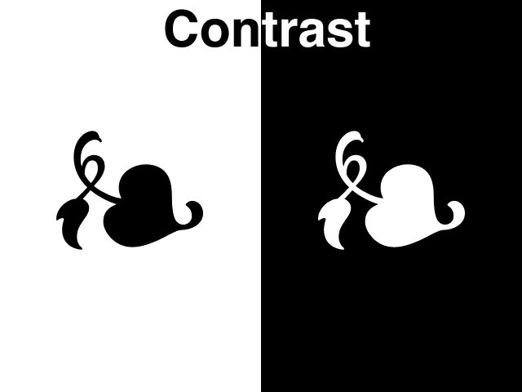
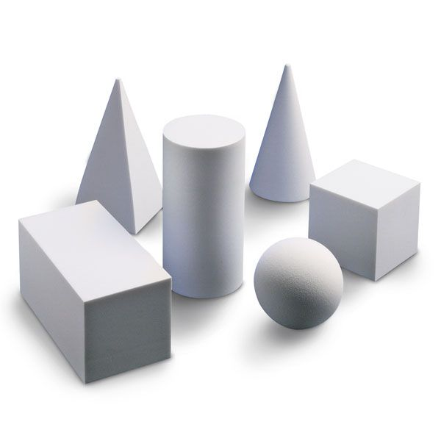
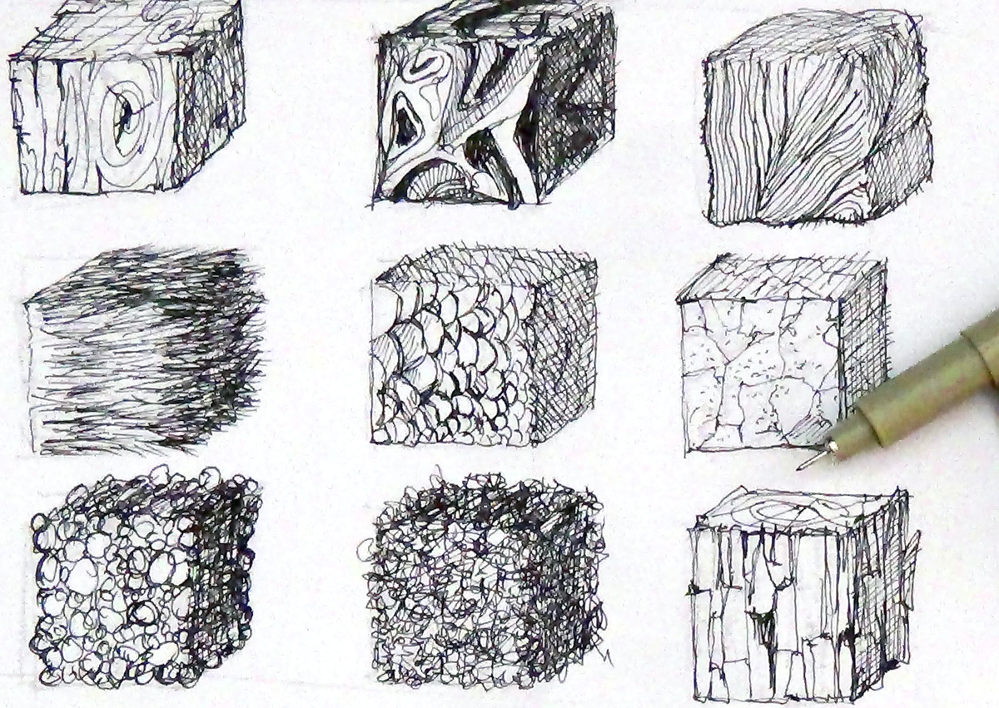
Sketchbook Warm-up
WRITE + DRAW (10 minutes):
Write down the definition of the 2 Elements of Art you chose for the logo.
Draw 6 examples of each element using basic shapes.
Form
Space
Texture

Slide 2
The Art of Logo Design
Some questions to ask yourself while watching this…
What makes a logo successful?
What do designers consider when making a logo?
What is the design process? Why is it important?
What is timelessness?
https://www.youtube.com/watch?v=x3jTSB2ez-g

Slide 3
Logos of Los Angeles
TODAY
Finalize your thumbnails (they should be finished, they were homework!)
Begin work on your Rough Drafts (if we have talked, I’ve given feedback, and/or I’ve given you the “green light”)
Bring your finished variations up to me for feedback and I will help you select 3 variations to develop into Rough Drafts
Use the remainder of class to work on refining Rough Drafts

