Slide 1
WARM-UP
Write (5 minutes):
You turn on the television and your program is interrupted by a Special Report.
“Breaking News, US satellites have picked up the heat signature of three
projectiles heading toward the west coast of the country, anticipated to hit
California in an hour… Preliminary reports point to the launch origins to have
come from Pyongyang, North Korea. The military is scrambling to intercept.”
Who do you want to be with? What is running through your mind? Is there
anything you feel must be done in case the world is meeting it’s end?
Be thorough.

Slide 2
WARM-UP
Draw (5 minutes):
Illustrate the scene of post-nuclear fallout as you exit your bunker.
Think of things you see every day around your house…

Slide 3
AGENDA
Warm-Up
Exhibition Roll Call
Thematic Mood Boards Intro
Activity

Slide 4
THEMATIC MOOD BOARDS (60 minutes)
(Ideas + Inspiration)
Do
In Photoshop, create a Mood Board on your Exhibition theme.
Document size: 17” x 11” / Fill the board!
Make sure it’s RGB (document color mode)
How
FIRST, come up with 3 key words to describe your mood board tone.
Write those 3 key words down in your sketchbook.
Use images, textures, colors, artwork, and text to set the mood and tone.

Slide 5
Function
A mood board should represent a unified and obvious idea!
Aim to get an emotional response.

Slide 7
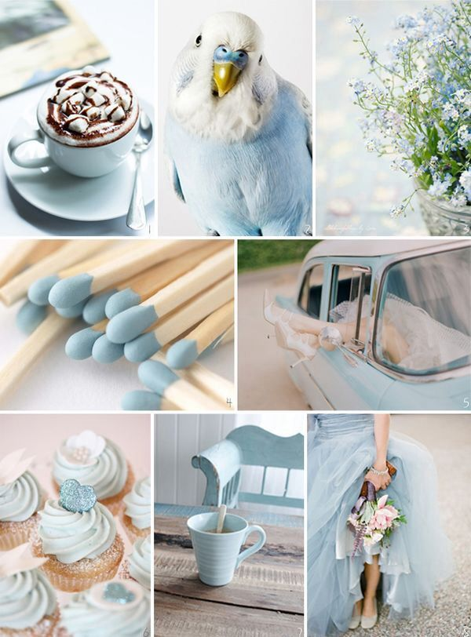

Slide 8
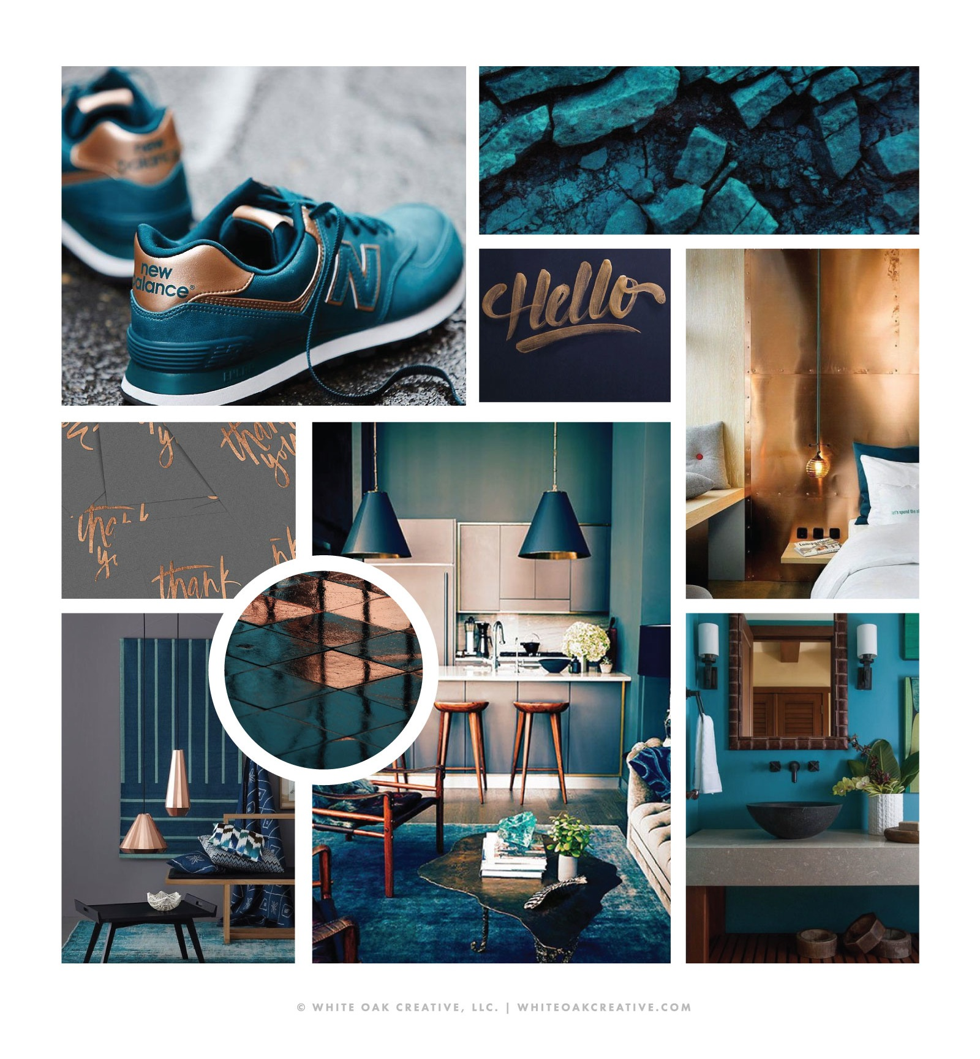

Slide 10
Post-mood board
You will review your team members mood boards to Compare / Contrast.
This should take 5-10 minutes.
Do the Compare / Contrast in your sketchbook.
Things to ask / answer:
How is your work similar? How is it different?
What did you miss? What did they miss? How is their work a better
representation of your theme? How can you improve yours?
How can they improve theirs?
After you’ve written out your Compare / Contrast in your sketchbook,
share your findings! (5 minutes)

Slide 11
THEMATIC MOOD BOARD PITCH
Save your mood board as a PDF.
Email yourself your mood board / save it to Google Drive.
You will present your mood board on the projector in a 3 minute presentation.
You will be graded on this criteria:
Quality / Mood board is well thought-out, complete with various elements, ideas, etc
Connections / Mood board communicates a concrete idea and mood

