Slide 1
Read the following article and answer the questions on a sheet of paper.
A Secret Message Hidden In A CIA Sculpture 25 Years Ago Might Finally Be Solved
Julie Bort
Like something from a Dan Brown novel, Kryptos is a cryptographic puzzle at CIA headquarters that has never been solved.
The sculpture is 12 feet high, and stands on the grounds of the CIA complex in Langley, Virginia. American artist Jim Sanborn built it 25 years ago.
Kryptos contains four hidden messages, carved out of metal. Those four messages are the clues to a riddle. Sanborn has hinted that solving the riddle will be something akin to a treasure hunt on the grounds of the CIA's headquarters.
Three of the messages hidden in the sculpture have been solved. The fourth is 97 letters but no one has been able to decipher it. Even the code-cracking masters at the NSA, who were the first ones to solve the other three parts, gave up.

Slide 2
In honor of the 25th anniversary of the fall of the Berlin Wall and Sanborn's 69th birthday, the artist has released a clue, a hint to the world's smartest mathematicians and cryptographers to help them finally crack the last section of code.
This is only the second hint he's ever given to crack the code that hides the clues, reports Wired's Kim Zetter. Once all four clues have been revealed, the next step will be to solve the riddle itself.
Zetter reports:
Four years ago, concerned that he might not live to see the mystery of Kryptos resolved, Sanborn released a clue to help things along, revealing that six of the last 97 letters when decrypted spell the word “Berlin”... To that clue today, he’s adding the next word in the sequence—“clock”... Now the Kryptos sleuths just have to unscramble the remaining 86 characters.

Slide 3
The first part of the puzzle that is a clue to the riddle is a poetic phrase that Sanborn composed:
"Between subtle shading and the absence of light lies the nuance of iqlusion."
The second indicates that the solution to the riddle may be a thing that's buried in the ground:
"It was totally invisible. How’s that possible? They used the earth’s magnetic field. x The information was gathered and transmitted undergruund to an unknown location. x Does Langley know about this? They should: it’s buried out there somewhere. x Who knows the exact location? Only WW. This was his last message. x Thirty eight degrees fifty seven minutes six point five seconds north, seventy seven degrees eight minutes forty four seconds west. x Layer two."

Slide 4
The third message is a description of opening King Tut’s tomb when it was discovered in 1922 based on the diary of Archaeologist Howard Carter.
"Slowly, desperately, the remains of passage debris that encumbered the lower part of the doorway was removed. With trembling hands I made a tiny breach in the upper left-hand corner. And then, widening the hole a little, I inserted the candle and peered in. The hot air escaping from the chamber caused the flame to flicker, but presently details of the room within emerged from the mist. x Can you see anything? q"
The code has been particularly hard to crack in part because some of the worlds have been misspelled like "iqlusion and "undergruund."
Sanborn told Wired that he's the only man alive that knows the answer to the riddle. So if the world's smartest crypto-mathematicians don't crack the fourth clue and solve the riddle while Sanborn is still alive, the mystery gracing the grounds of the CIA may remain hidden forever.

Slide 6
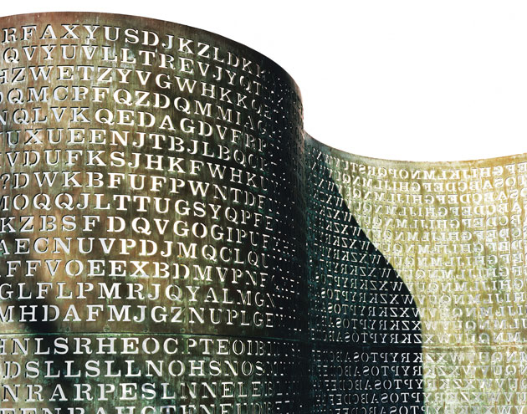

Slide 7
Questions:
What does Kryptos mean?
What is cryptography?
What is the appeal of solving puzzles, riddles, etc?
How can we utilize encryption in our escape room puzzles?
What makes a fun riddle or puzzle?

