Slide 1
REMINDERS:
Logos due Friday, 9/15
Sketchbook Check / Details via Weebly

Slide 2
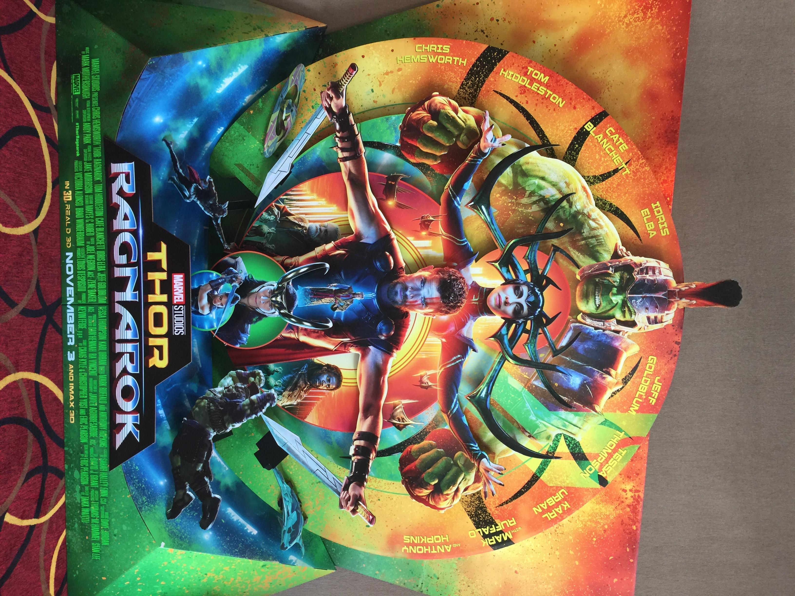
WARM-UP
Write (5 Minutes):
Describe this poster in terms of the Elements of Art.
Name the multiple elements
inherent in various parts of this
poster and be specific!
See how many you can find!
Share Out.

Slide 3
Draw (10 minutes):
Draw a square, triangle and a circle.
Utilizing these shapes as the focal part of each design, modify each shape to create individual logos.
Each logo is for a beach clothing wear brand.
Go!
Share out.

Slide 4
Illustrator Techniques
Grid - utilizing the Grid in Illustrator to build a consistent design theme
Rulers / Guides
Pen Tool
Pathfinder
Type Tool

Slide 5
Example of logo on Grid

