Slide 1
Escape Room Exhibition Fall 2017
Deliverable: Puzzle Poster
Dimensions: 18” x 24”
Digital Source : Illustrator / Photoshop
Due Date:

Slide 2
Puzzle Poster Details
Each designer in your group will come up with a separate Puzzle Poster design and you will all decide on the best version once you complete them. Your final designs will be guided by Critiques sprinkled throughout the weeks (rhyme). You must all, as a group (Architect Pathway teammates as well), decide which Puzzle Poster will be the most fitting addition to your escape room.
This Puzzle Poster will be an integral part of the series of puzzles you will be creating in your other classes to fulfill the 15-30 minute escape room expectation.

Slide 3
TIMELINE
Week 1 (Care) : Research / Themes / Sketches
Week 2 (Concept) : Puzzle Poster Thumbnails
Week 3 (Create / Critique) : Refining Thumbnails to Rough Drafts
Week 4 (Create / Critique) : Refining Rough Drafts to Final Drafts
Week 5 (Create / Critique) : Final Drafts to Digital
Week 6 (Critique / Create) : Refining Final Vector / Presentation
Critique means we’ll actually be doing critiques, both formal and informal… Informal being when I give you feedback during workshop days.

Slide 4
Poster Rubric Requirements / Super Important Stuff
Strong Thematic Connection to your Escape Room
TWO Elements of Art
Contain a decipherable hidden message in the form of a puzzle
(cipher, anagram, etc) that will reveal a clue to either the Final Escape
OR just another clue, your choice

Slide 5
the following samples are not to be stolen
they may be creatively expanded on
or ignored completely to pursue the utmost
creativity

Slide 6
Hidden Message in the form of a riddle
using a typographical treatment with
hand-lettering and utilizing contrast
and balance as its primary Elements of
Art.

Slide 7
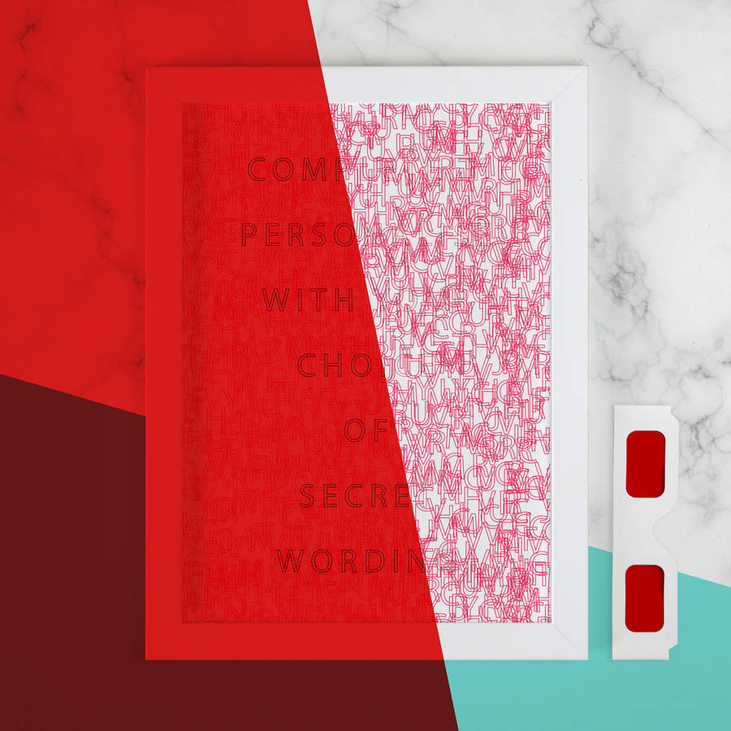
Hidden Message in the form of a decoder
using a typographical treatment with
hand-lettering and utilizing color
and balance as its primary Elements of
Art.

Slide 8
Hidden Message in the form of an anagram using an illustrated clue and utilizing emphasis and color as its primary Elements of Art.

Slide 9
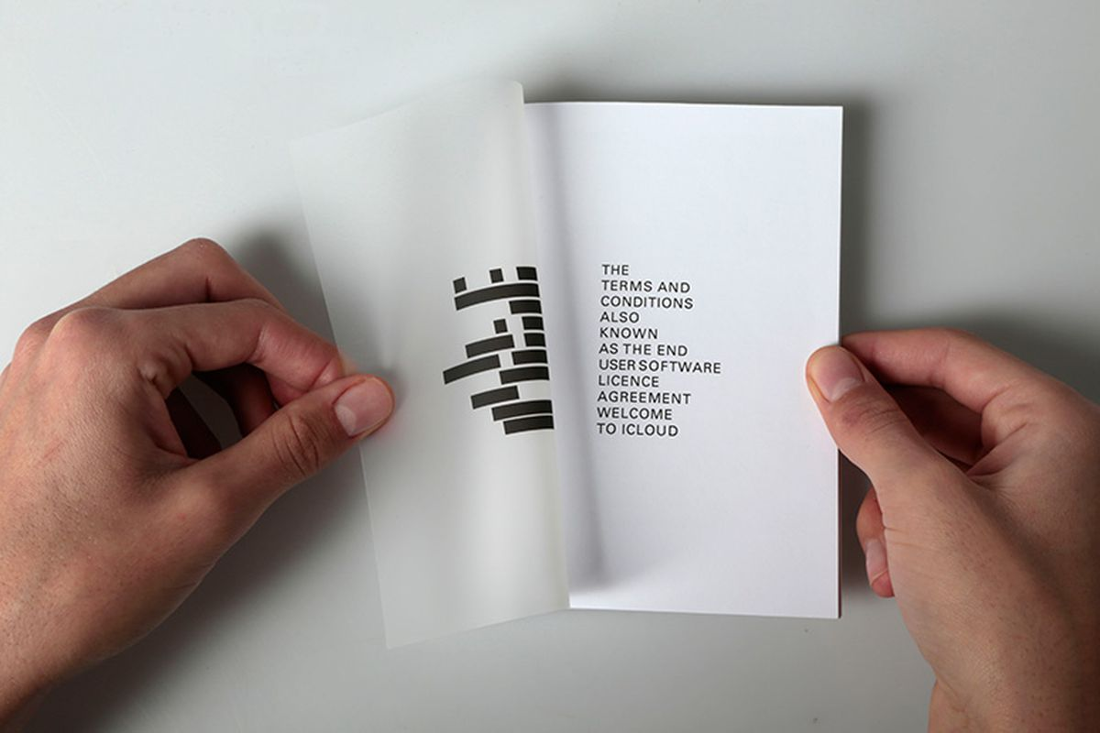
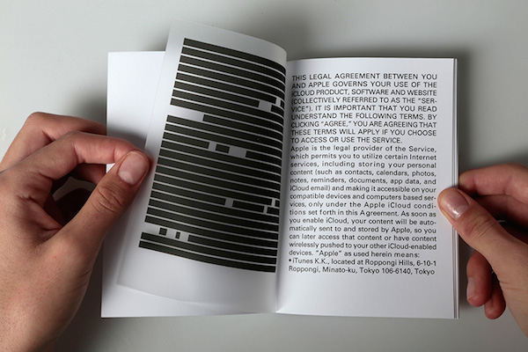
Hidden Message in the form of a decoder
using a typographical treatment and utilizing contrast and balance as its primary Elements of
Art. This is only a book
but can be a poster, incorporated into
a thematic backdrop.

Slide 10
push yourself to be original
to be exciting
to use your imagination

Slide 11
TODAY
(Super Important) Keep in mind your room themes!
Keep in mind / research the various types of puzzles you could incorporate!
Thumbnails
Before class ends, I will come around and check your progress
for a Habits of Mind (Accountability) grade.
This is not a walk around and talk day…
This is a Workshop Day to begin the work towards your final Puzzle Poster.
... godspeed.

